Slide 1
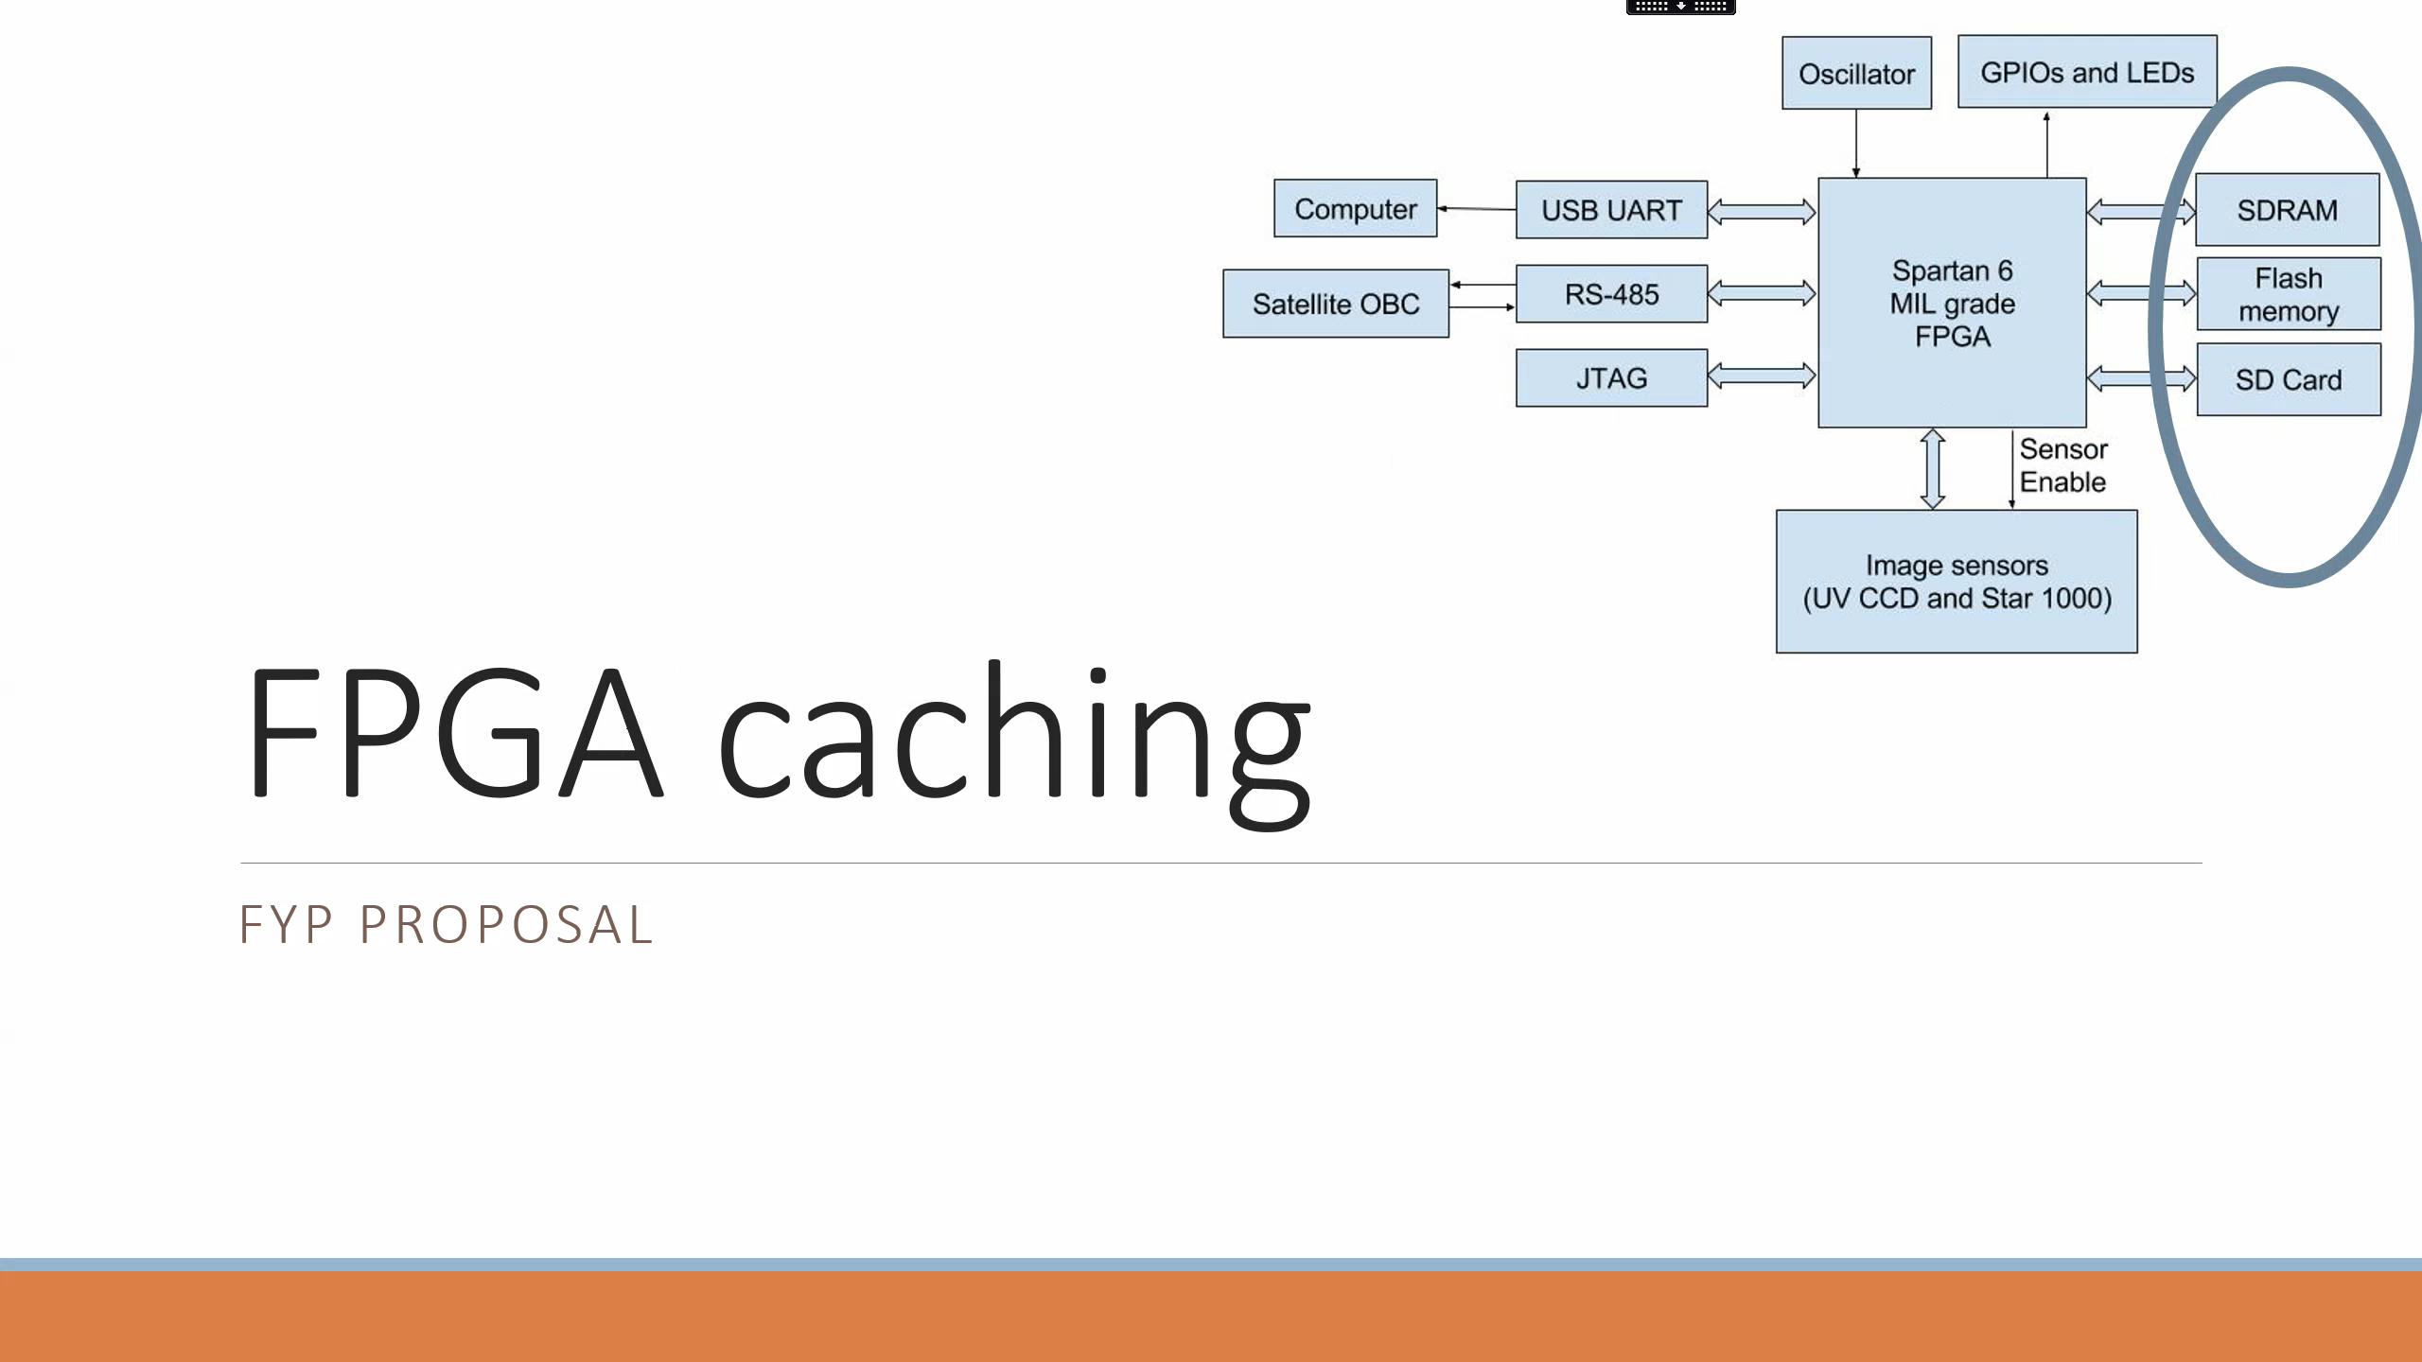

Slide 2
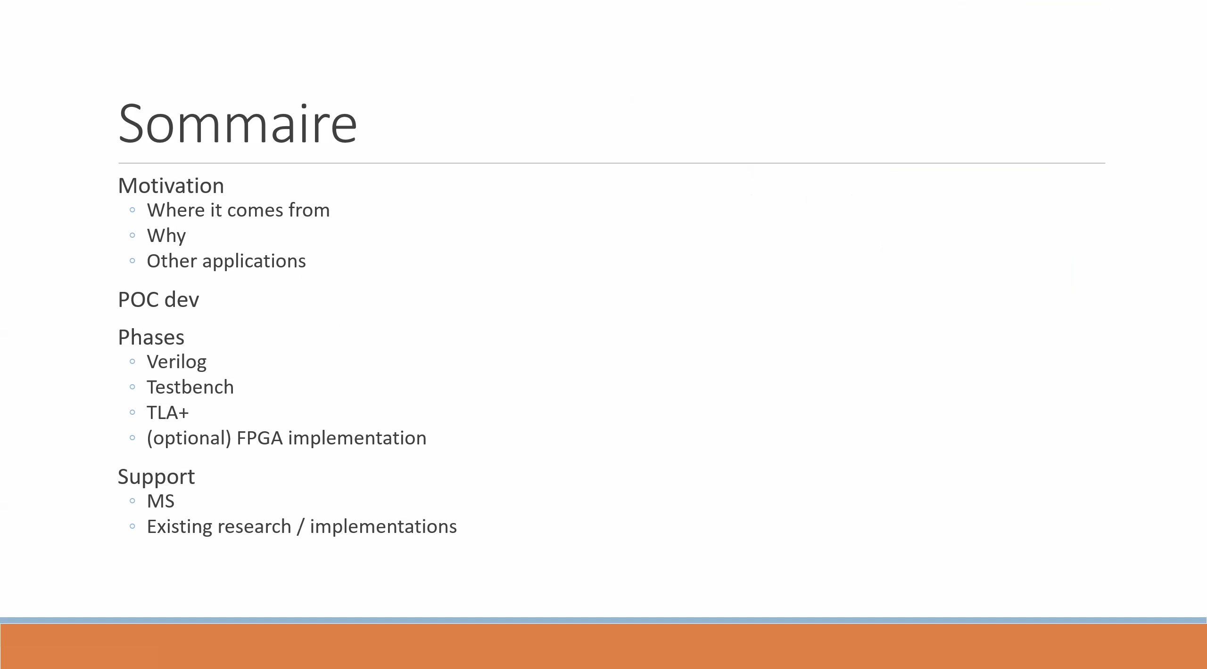

Slide 3
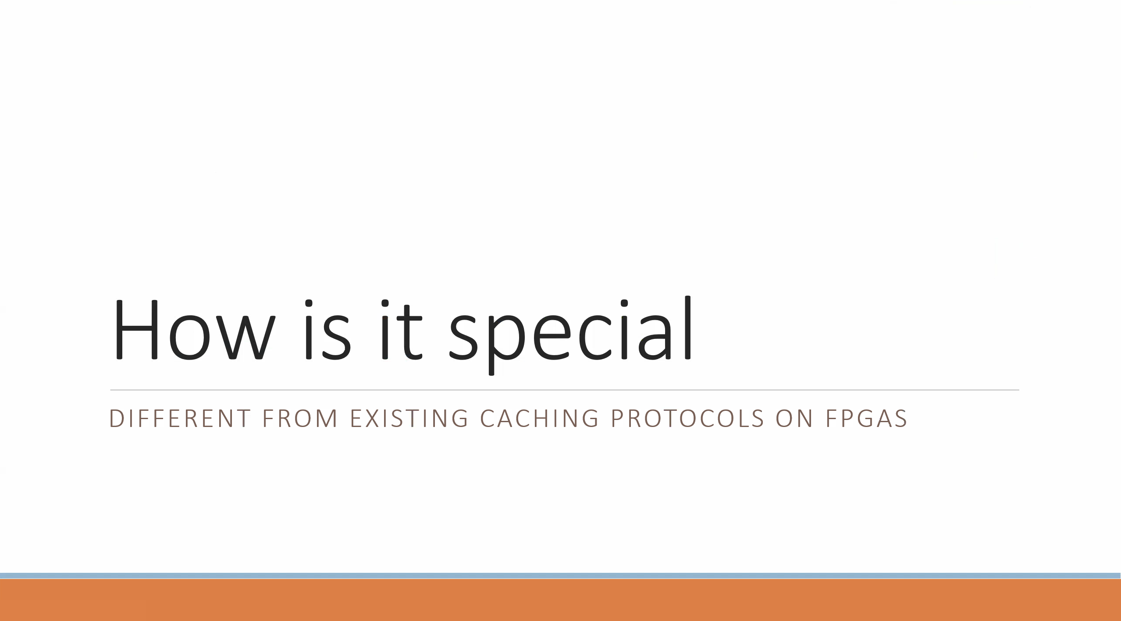

Slide 4
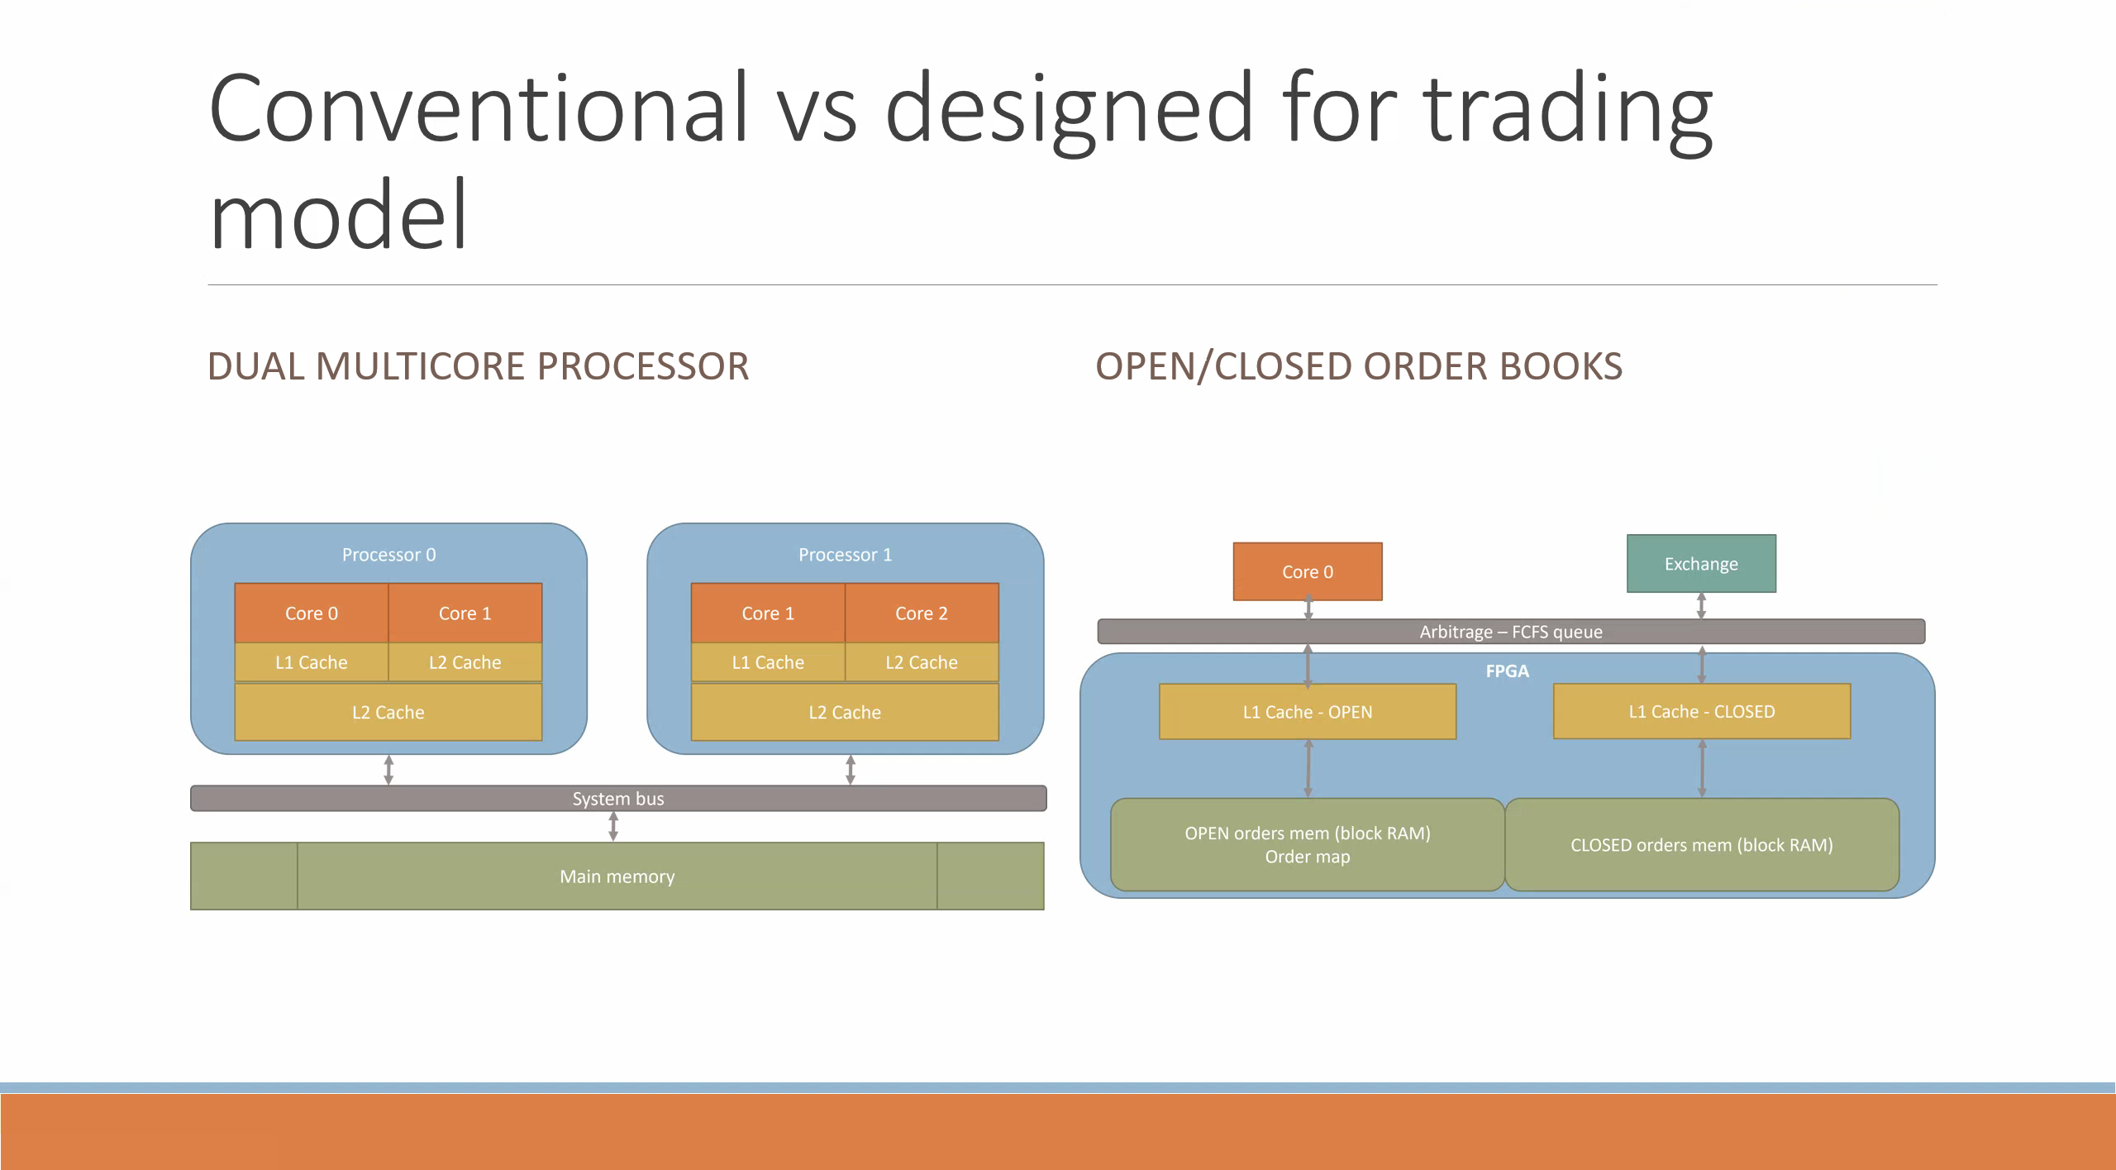

Slide 5
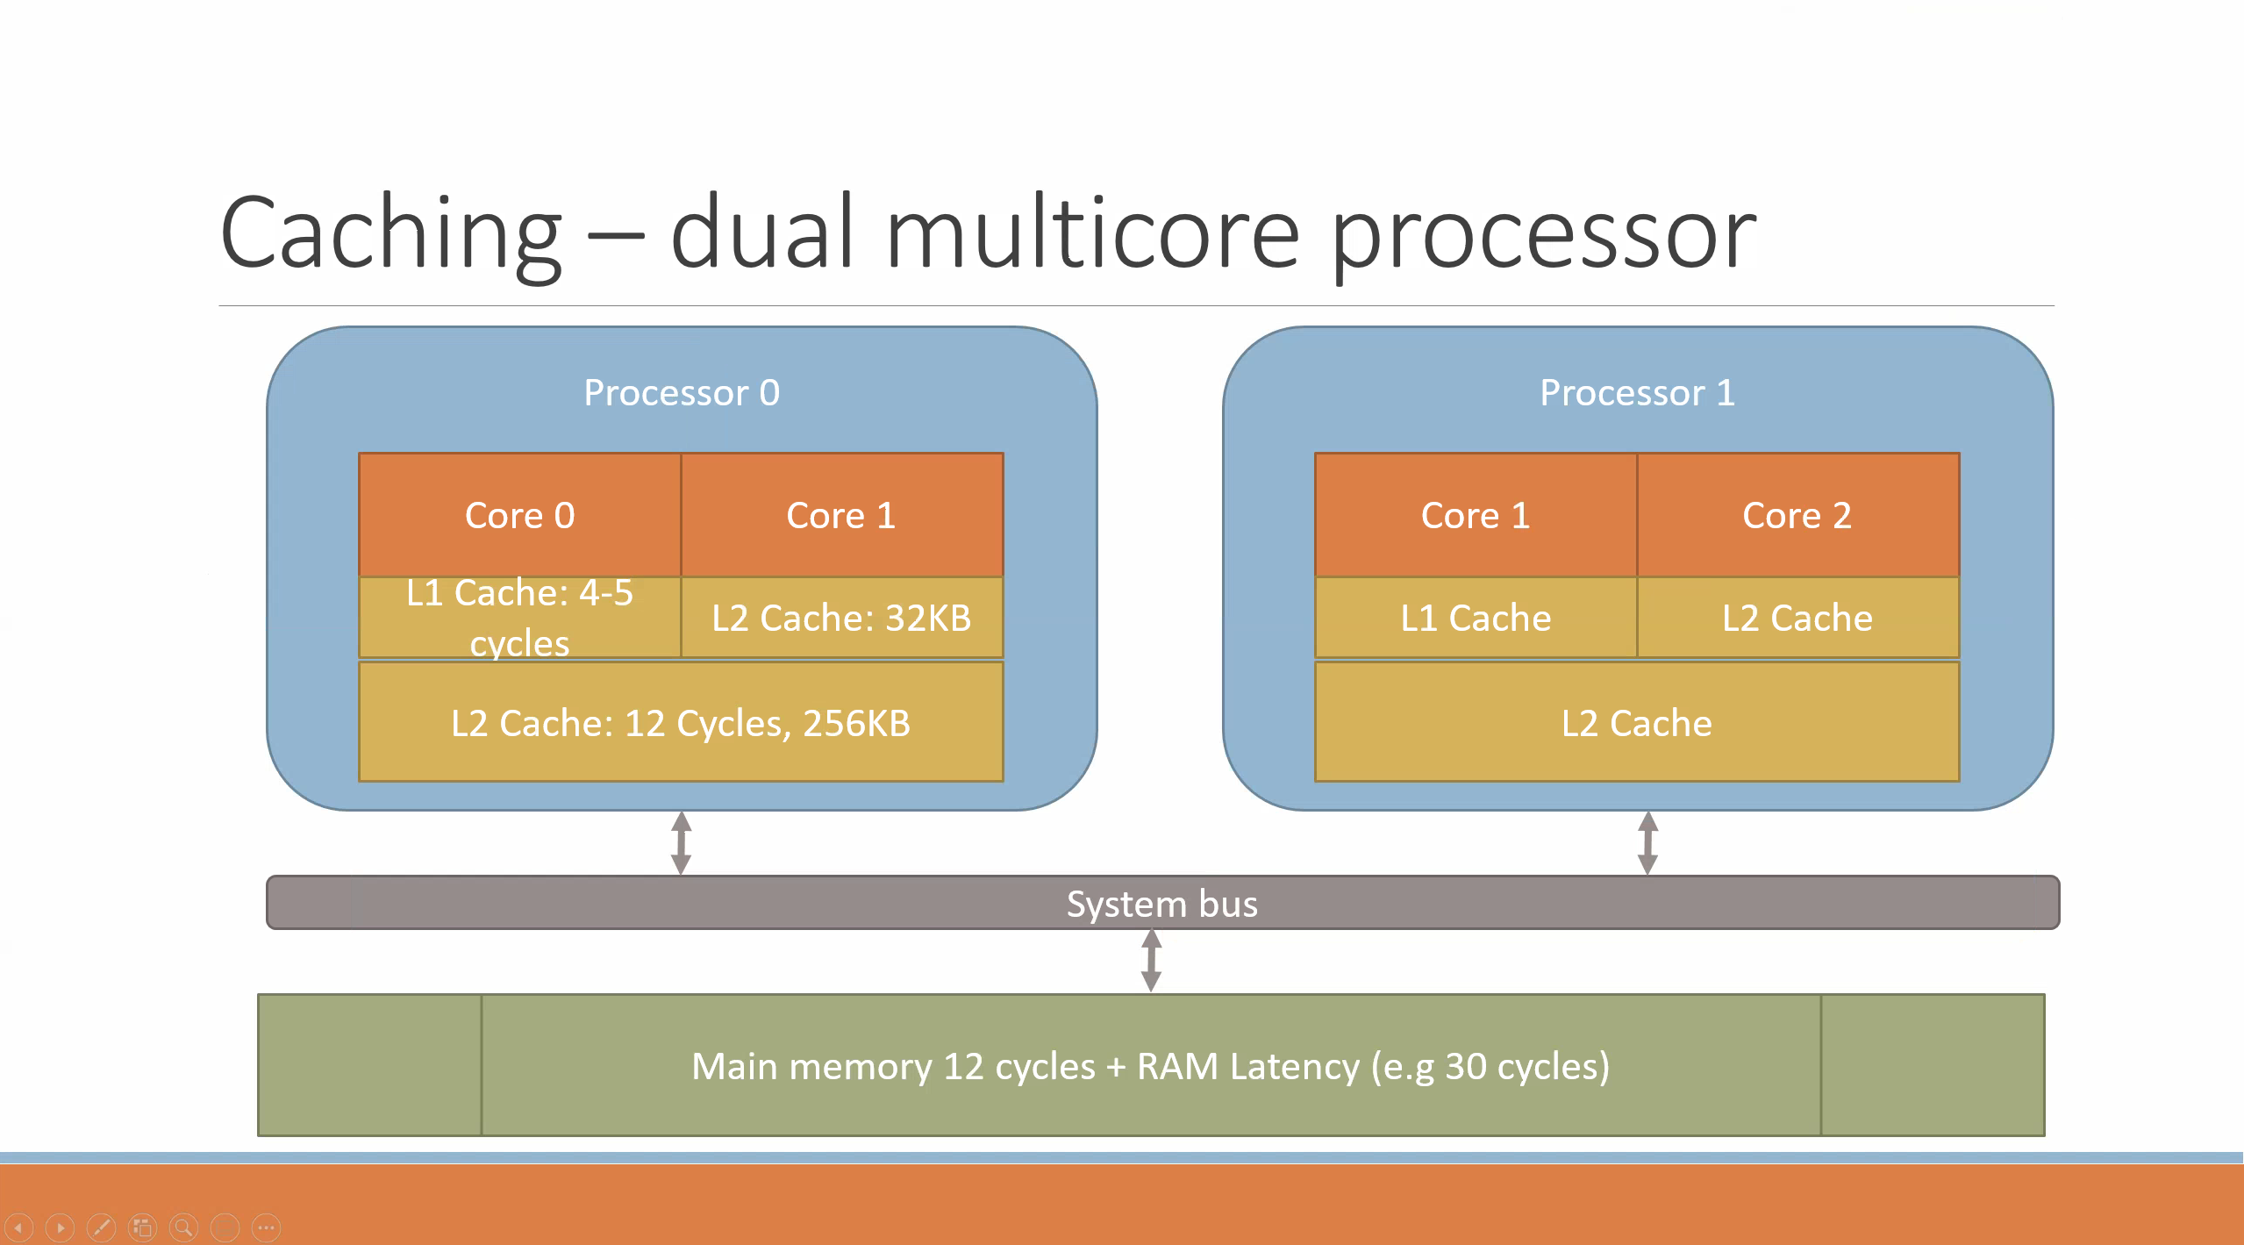

Slide 6
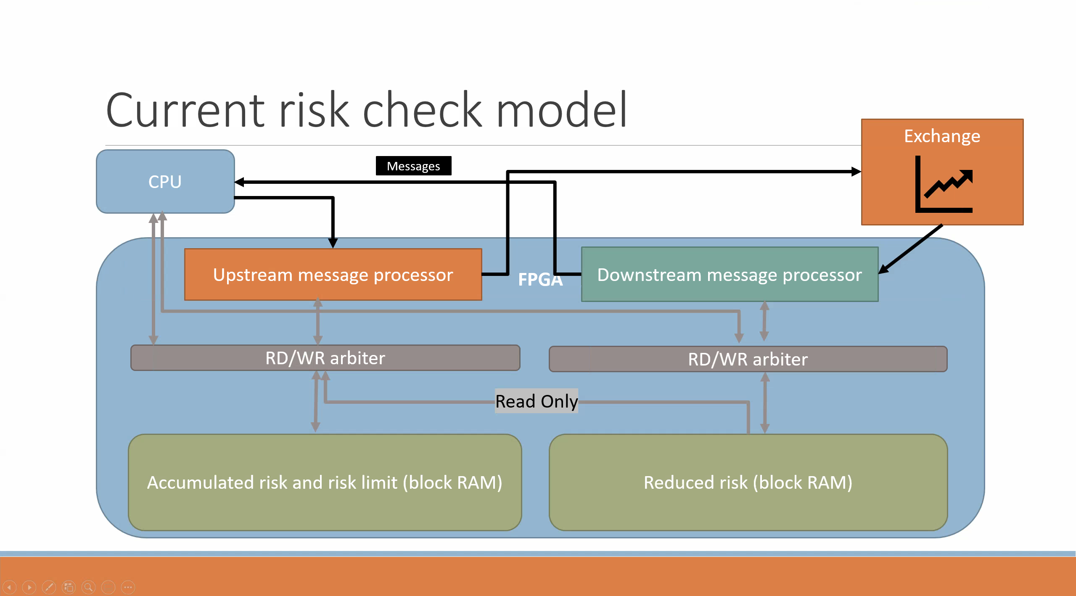

Slide 7
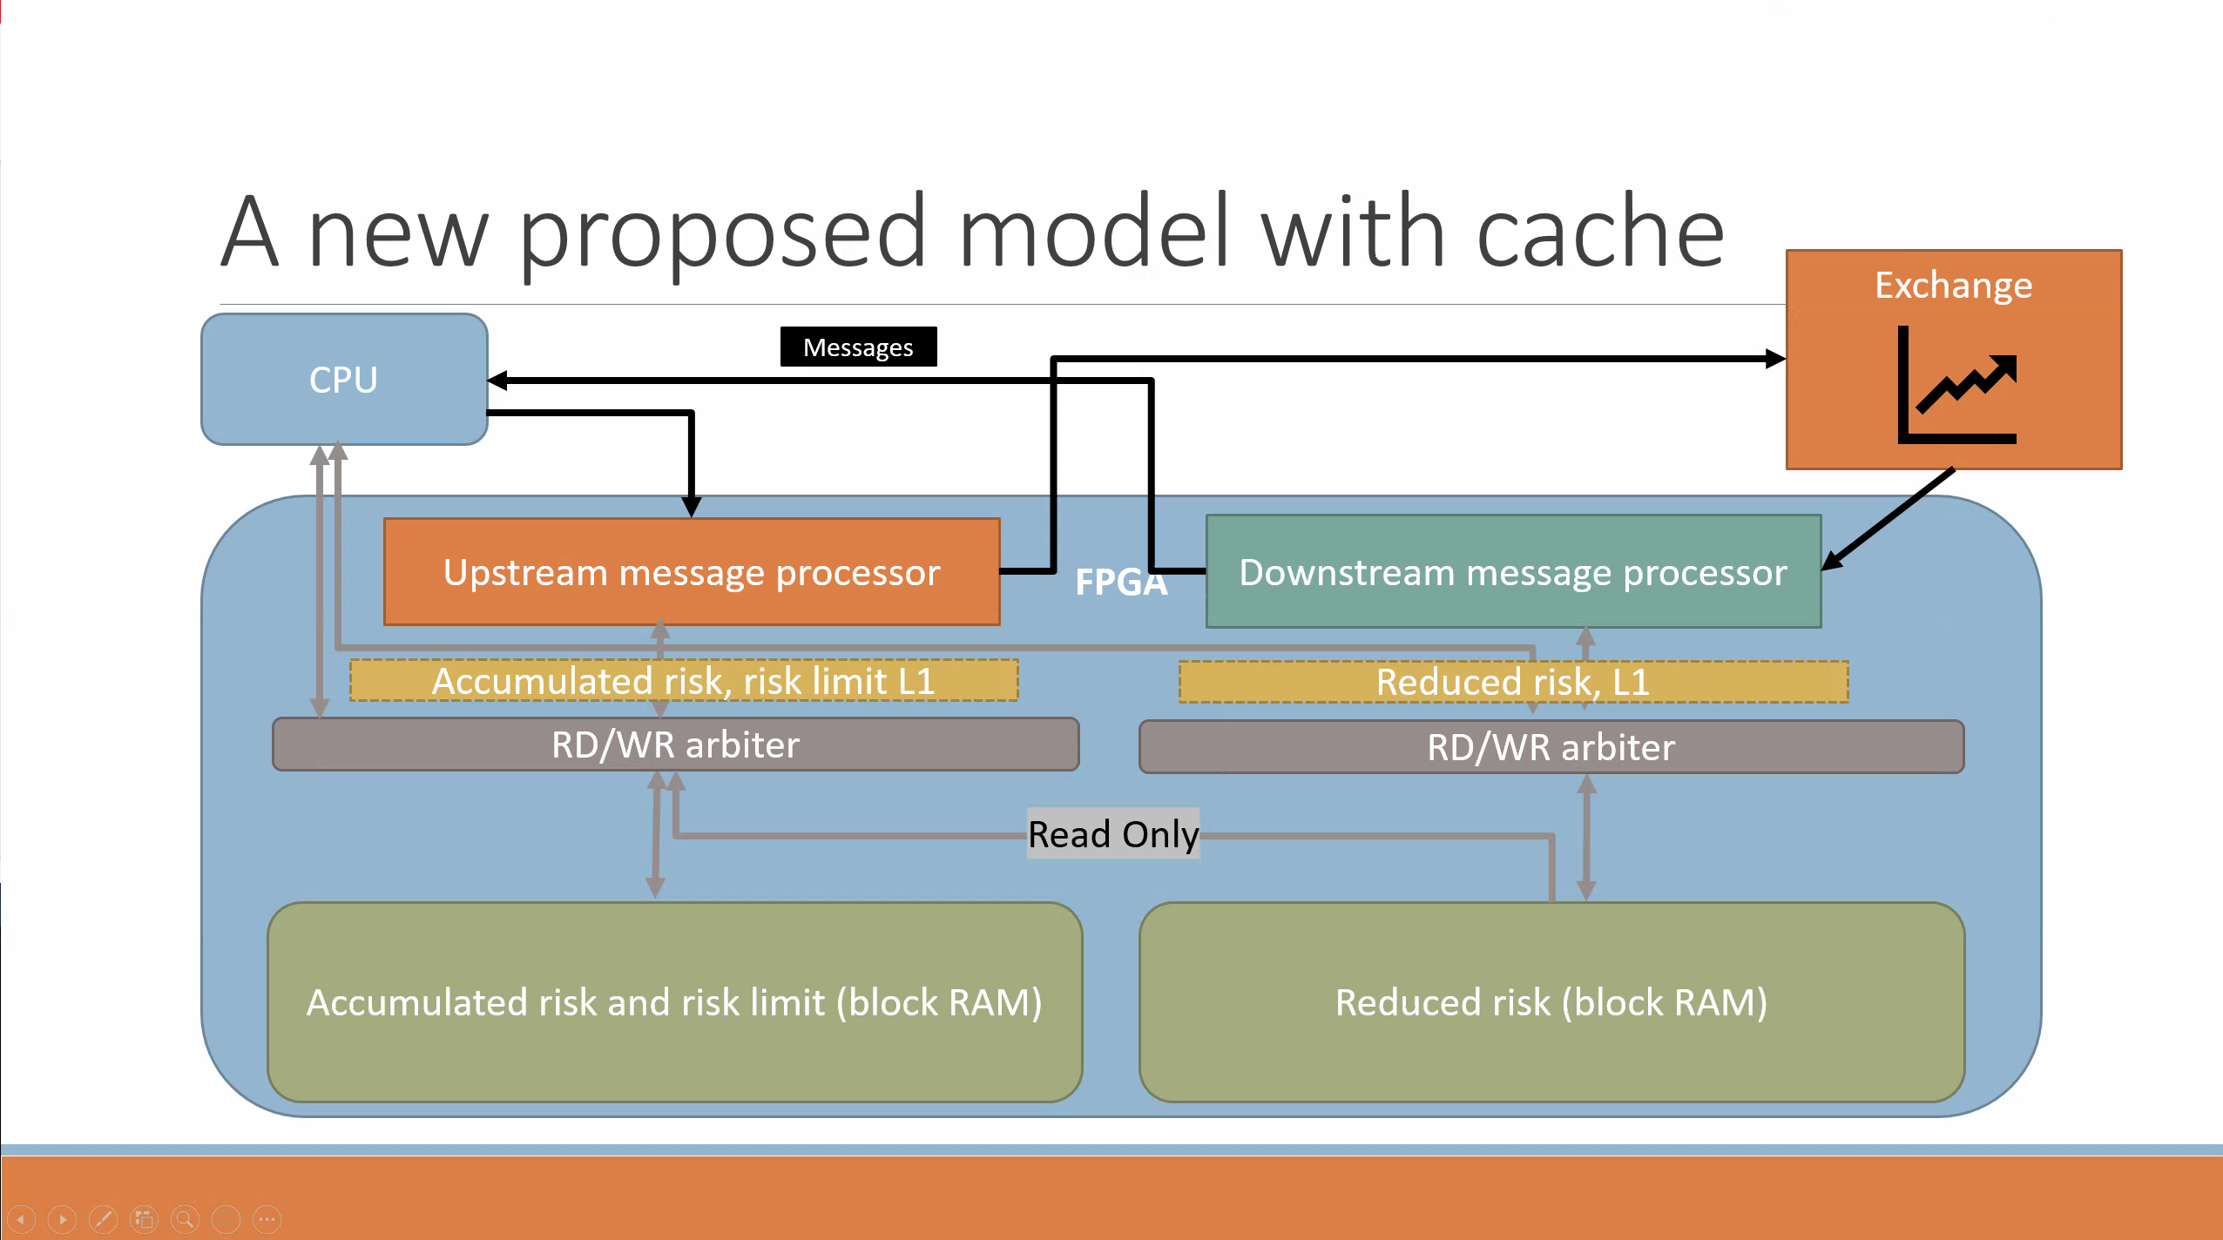

Slide 8
Example – current Model
Different scenarios from which we can build state machine

Slide 9
Case I – initialization and New Order
Default, most common cases

Slide 10
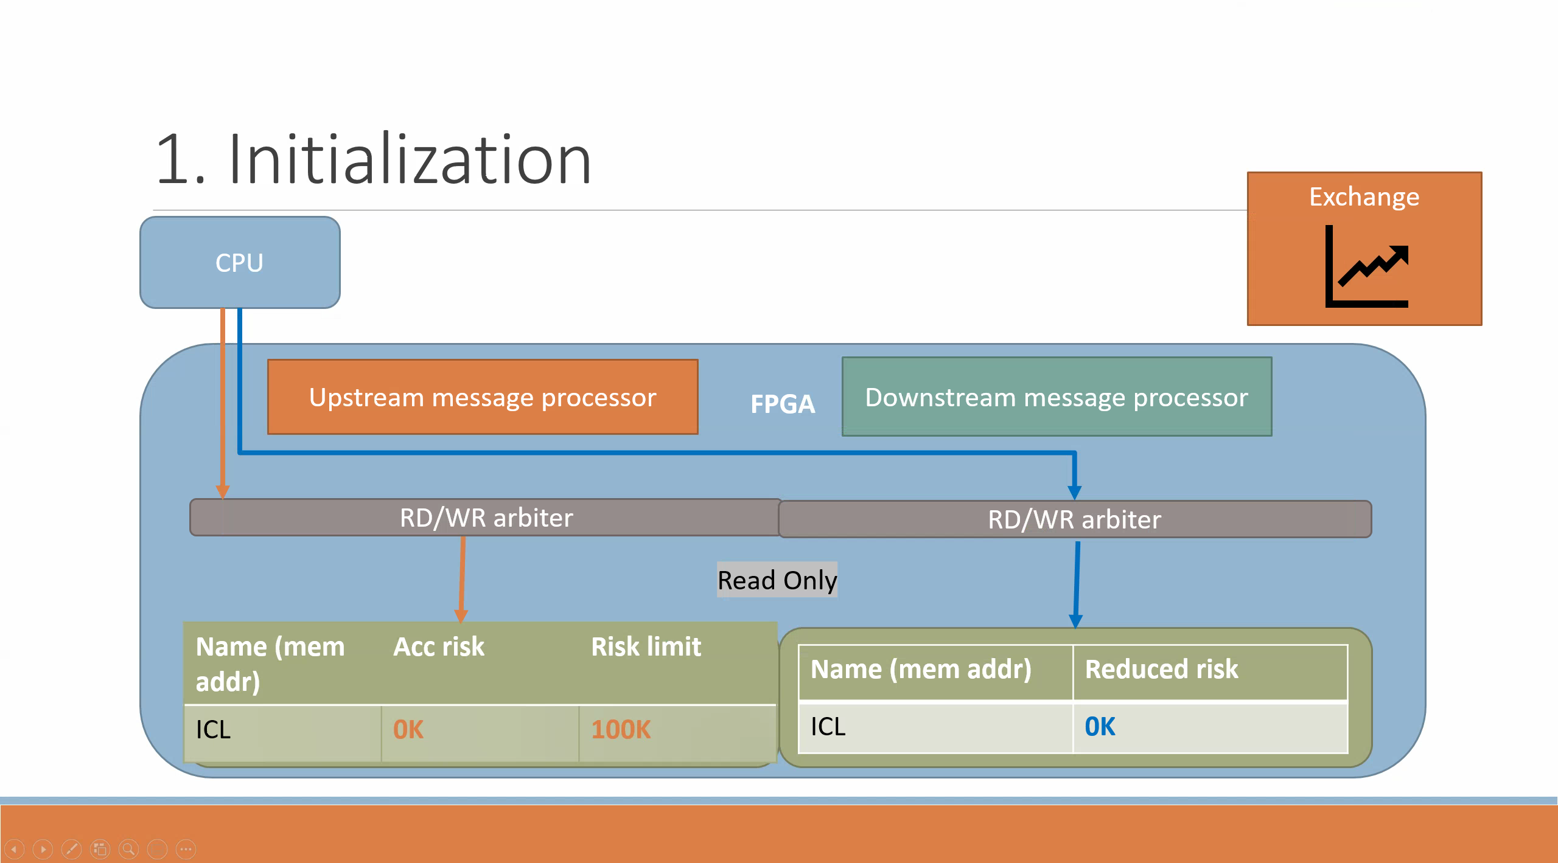

Slide 11
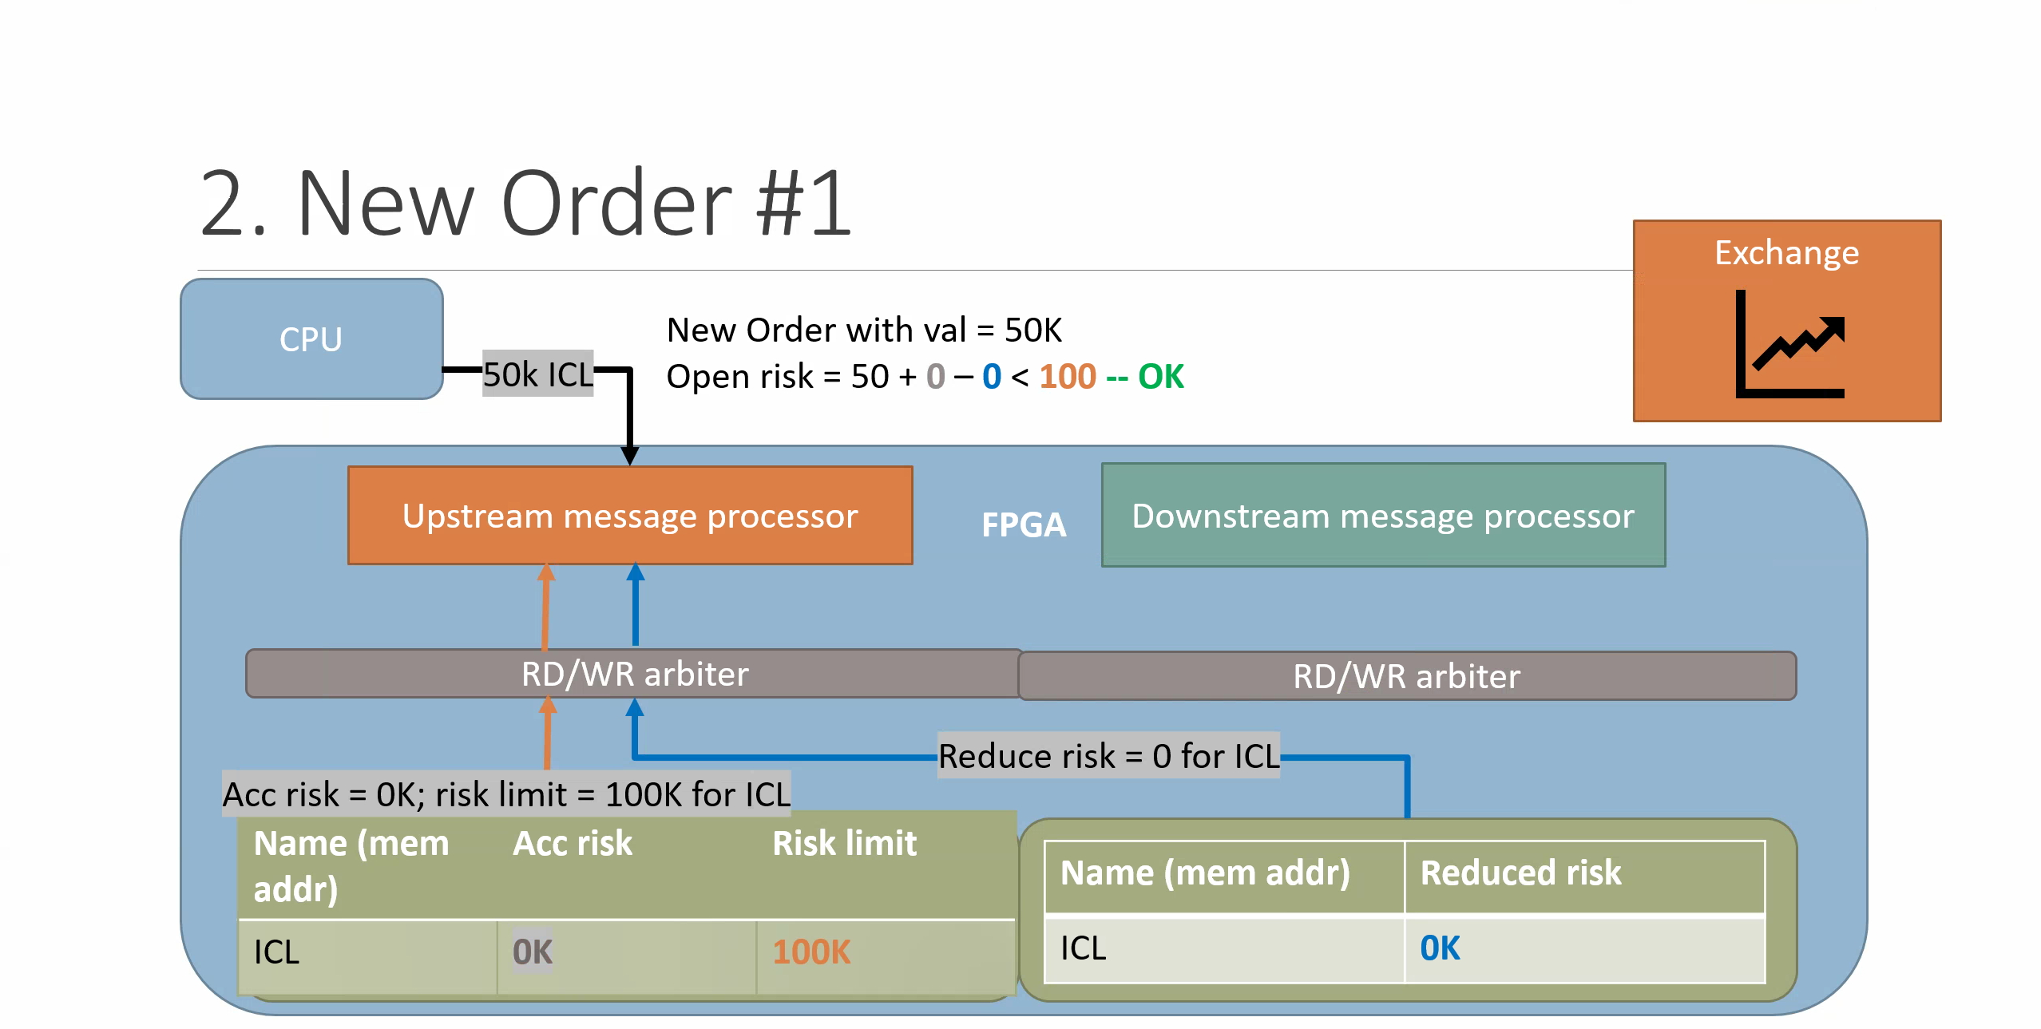

Slide 12
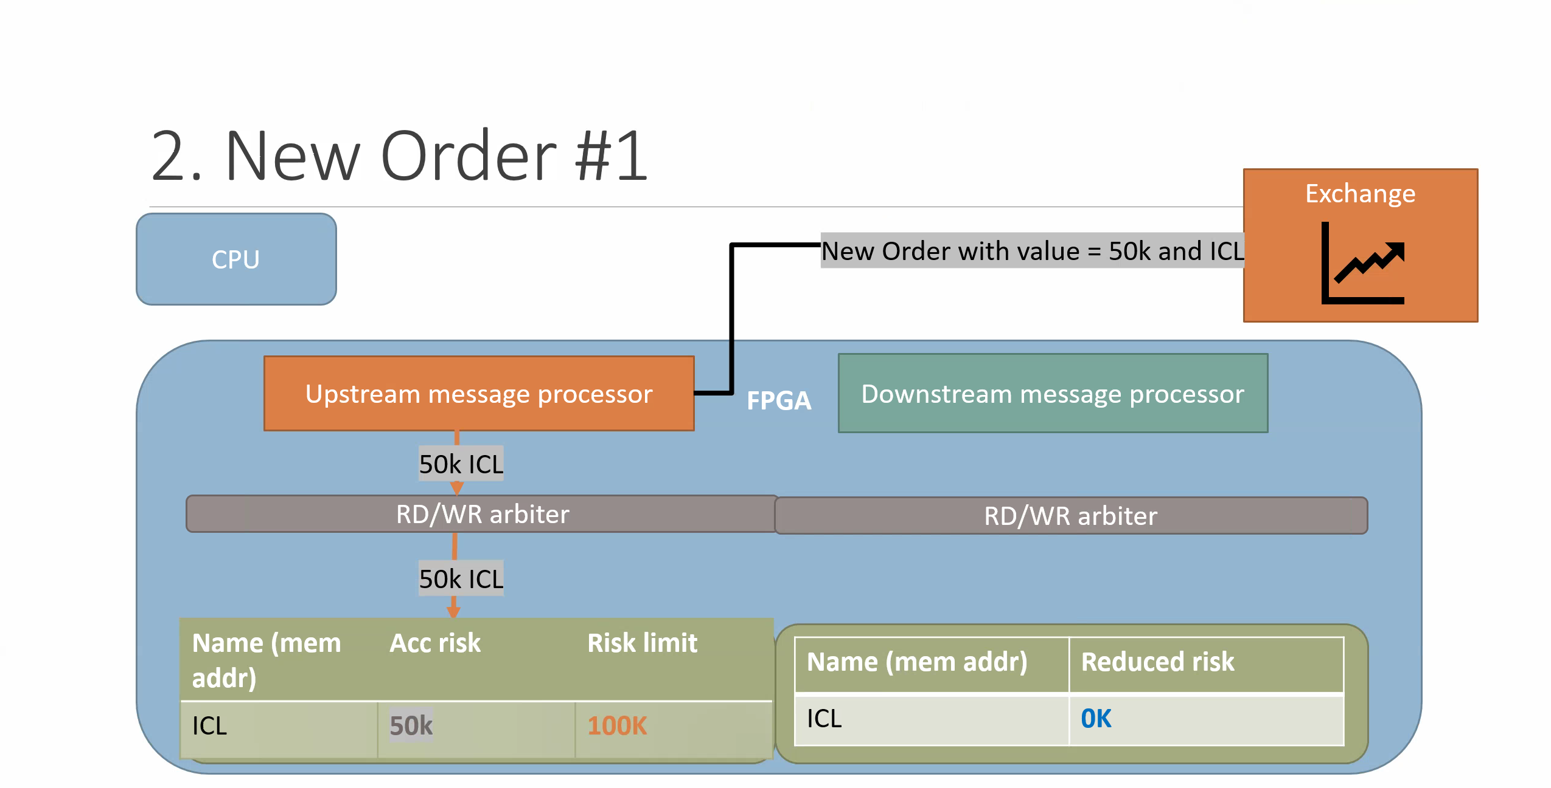

Slide 13
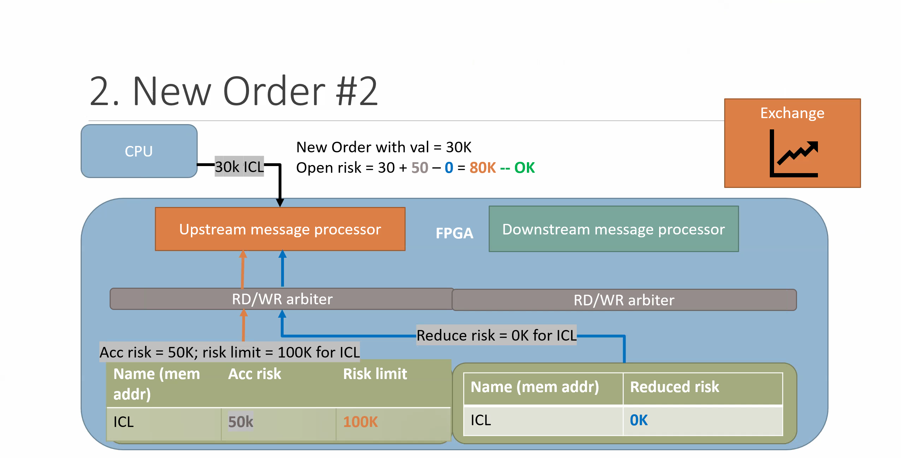

Slide 14
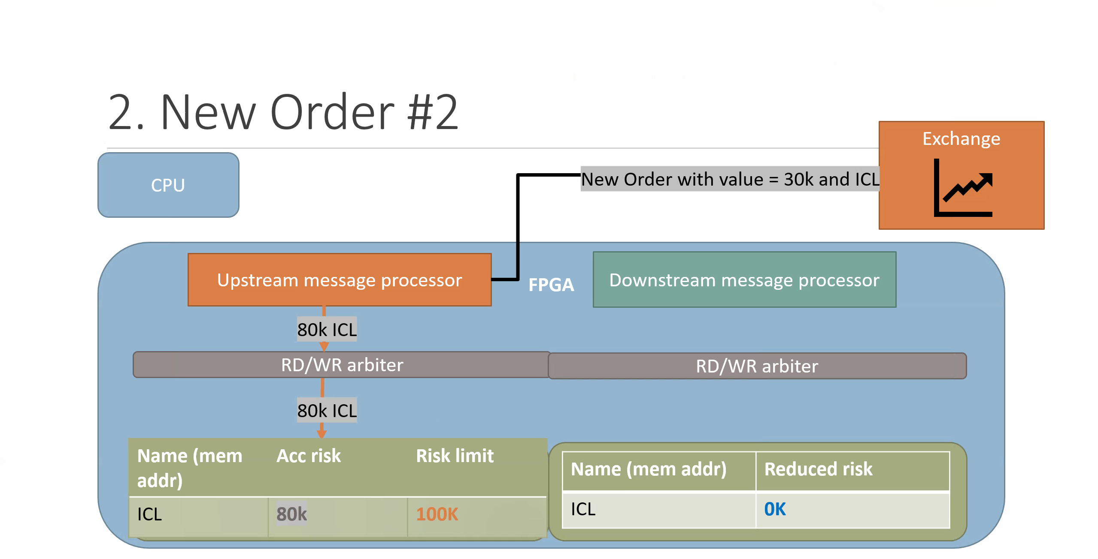

Slide 15


Slide 16
Case II – Cancel Order

Slide 17
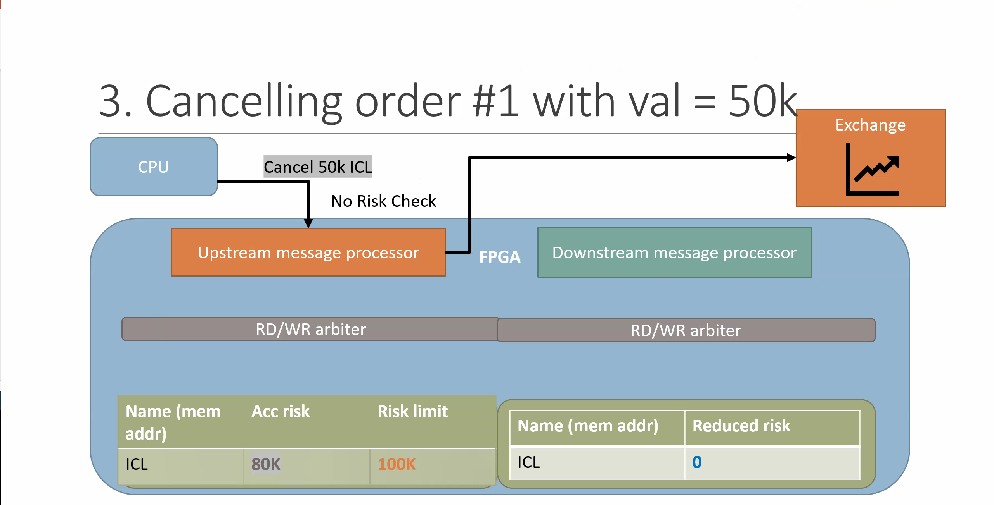

Slide 18
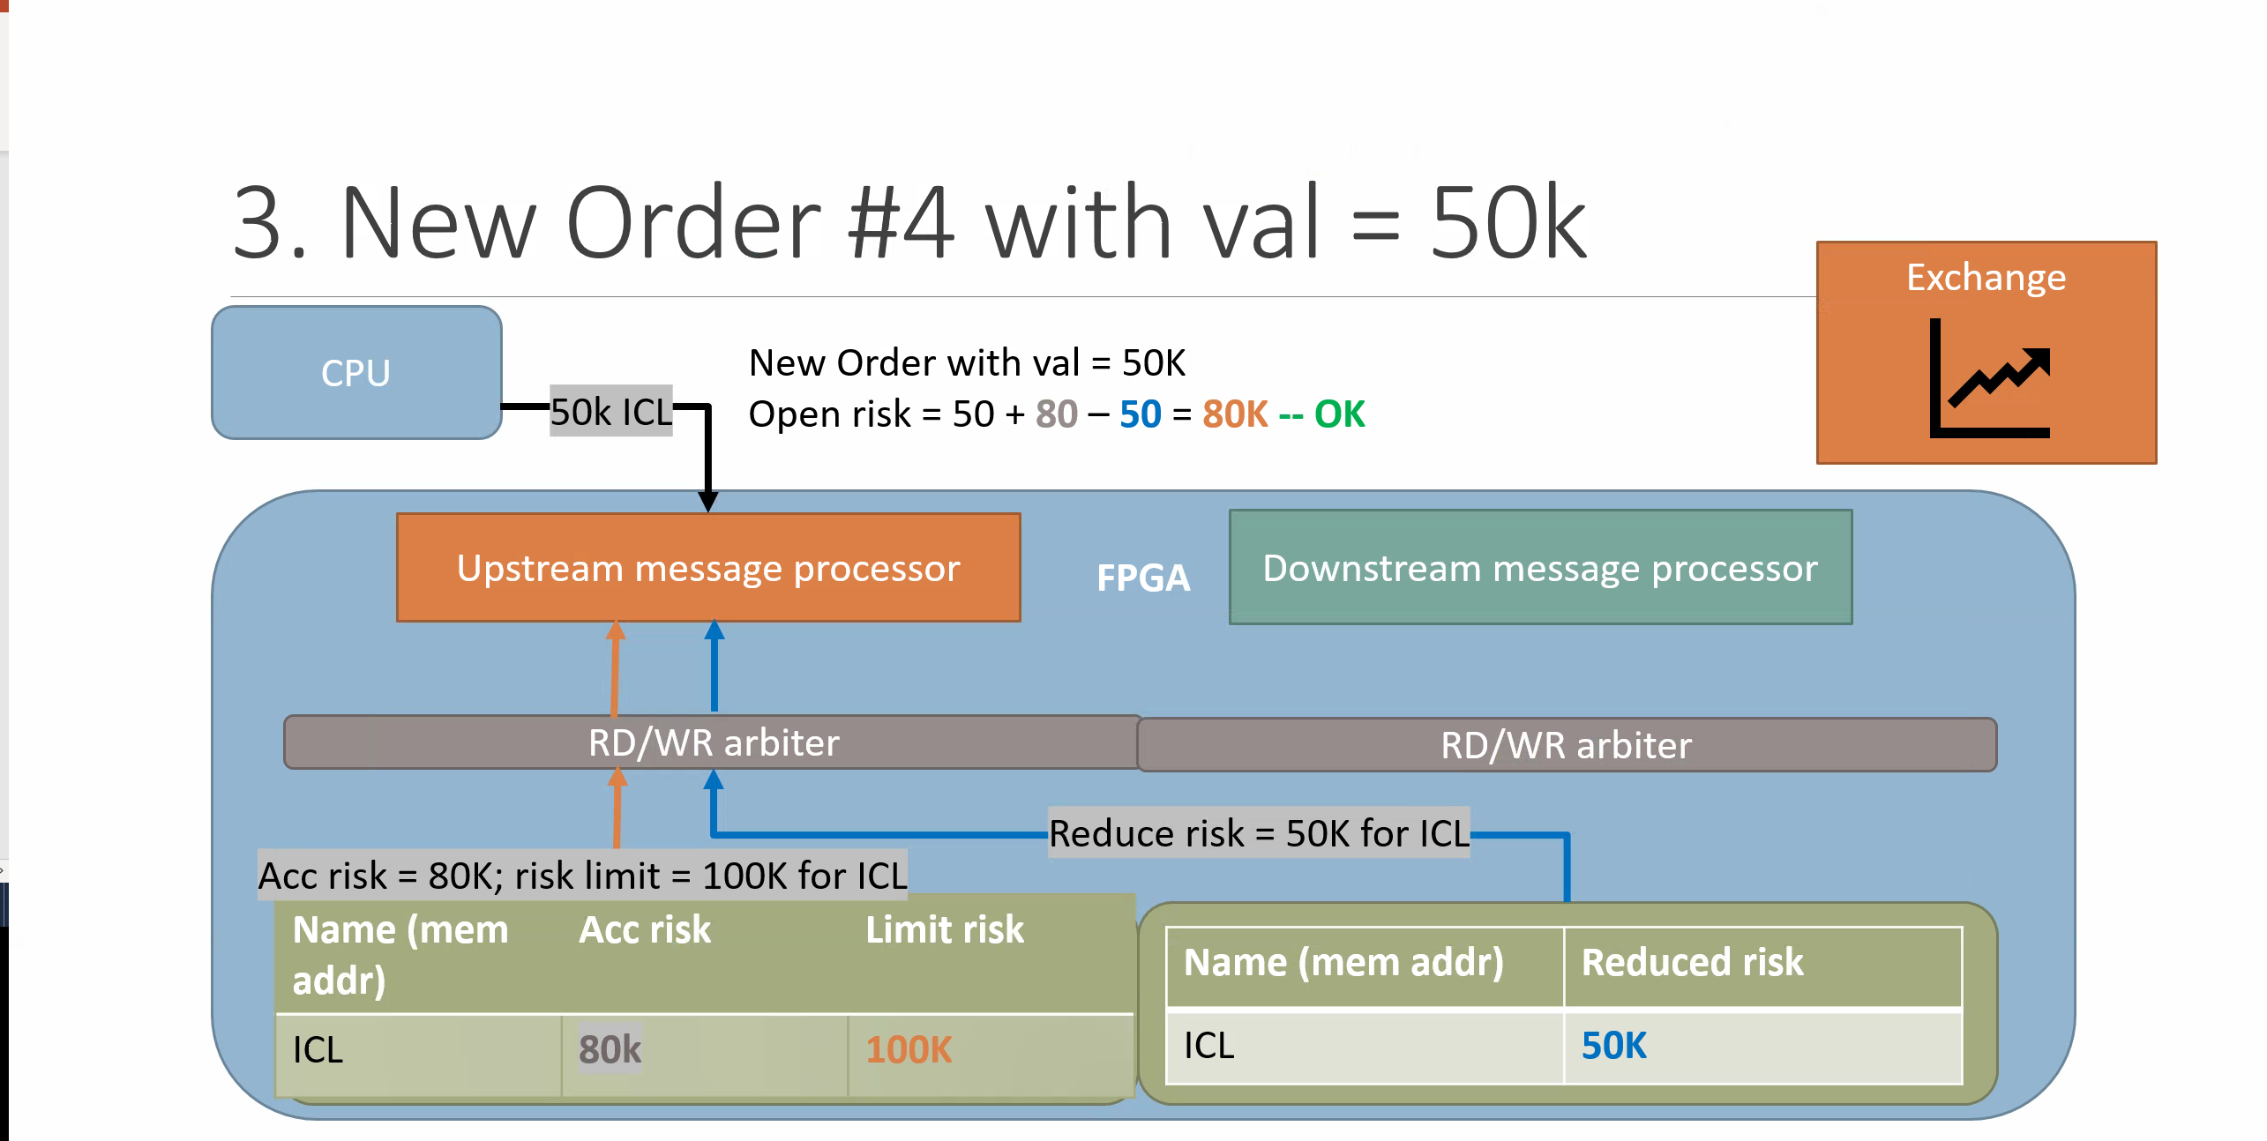

Slide 19


Slide 20
Case III – Simultaneous New Order and Cancel Ack
With 2-port dual-port block RAM

Slide 21
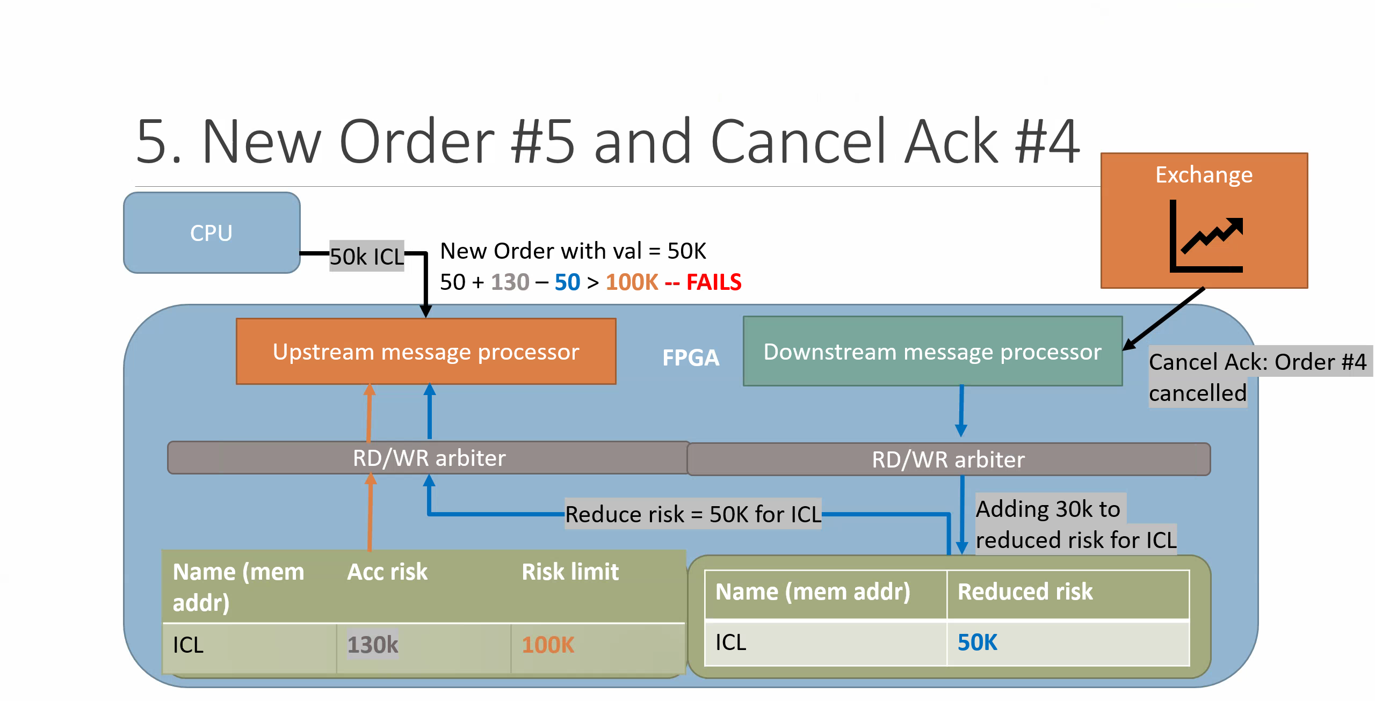

Slide 22
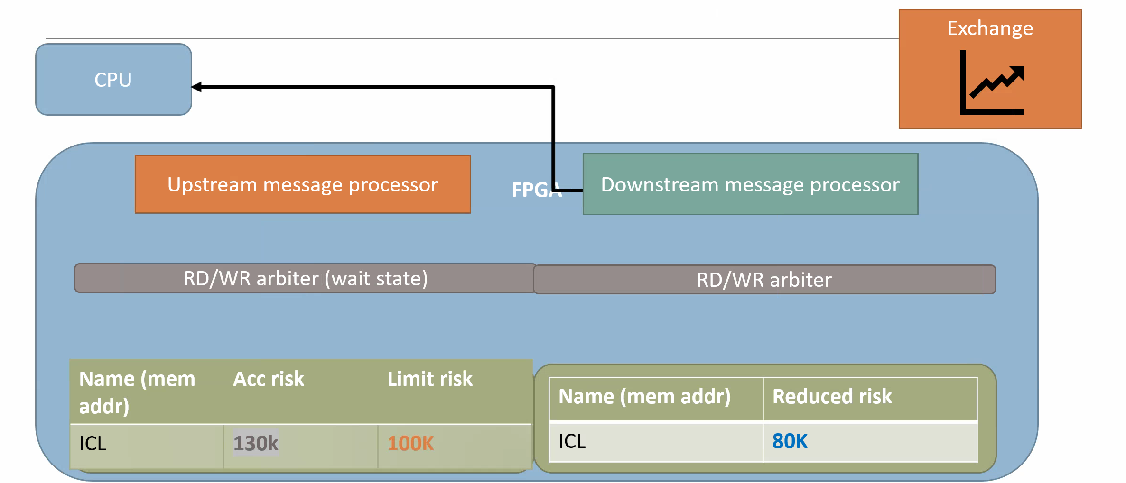
5. New Order #5 and Cancel Ack #4

Slide 23
Case IV – Simultaneous access to block same block RAM

Slide 24
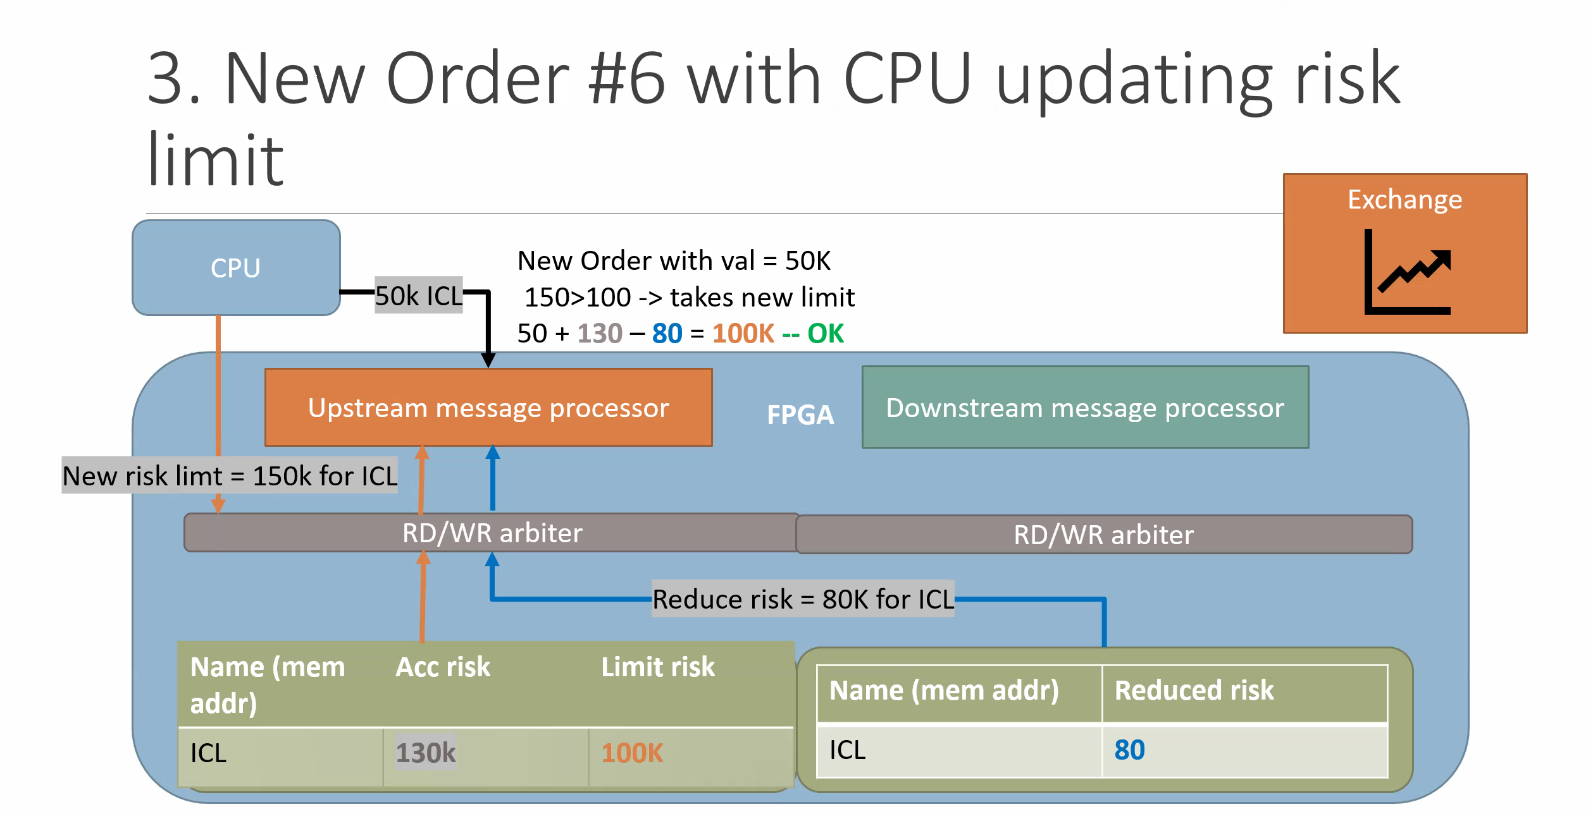

Slide 25
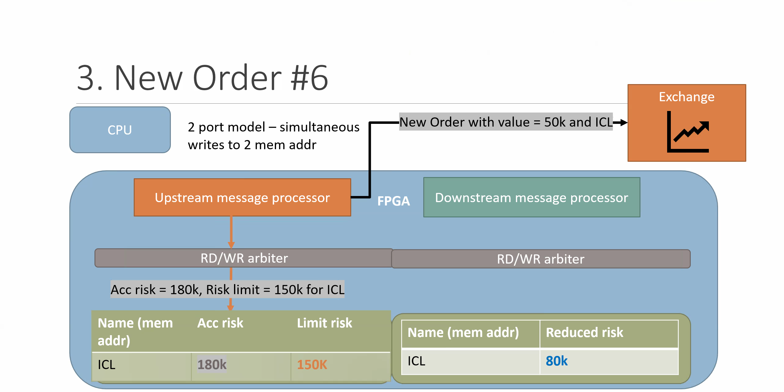

Slide 26
Ideas & Question – current model
Split 2 block RAM into 3 block RAM – Limit Order (1), Accumulative orders (2), Cancel orders (3)
Where to put the cache in the pipeline
Verilog implementation of current model
Processors → draw state machine and use Boolean logic
NO NEED FOR MEMORY Implementation – find how to “load” from questasim on FPGA and just create from user manual
Write testbench to “mimic” exchange and CPU for sending mass orders – this will be useful when adding the cache
Steps:
Logic drawings of current processors + agree on memory/processor structure
Verilog implementation (no caching)
Testbench
TLA+ to verify code or use Verilog for verification
Steps 1-4 adding a cache for each block RAM in design 1.

Slide 27
Notes & simplifications
Spec of message between quoterx and xetra
https://www.xetra/resource/blob/2744906/f71d34113b03e11ea68cf630d366b011/data/T7_Enhanced_Trading_Interface_-_Cash_Message_Reference_v.10.0-C0002.pdf
Assumption 1: We need to parse 2 messages only, discard anything else
1 New Order Single (short layout) cf Page 69)
Cancel order response (Lean Order) page 125
SecurityID is the field to identify the suymbols (e.g ICL in my example)
64 bit long number – assumption: start from 0 and matches address of block RAM
Assumption 2: symbols are the client: Map implemented as a hash table inside FPGA (symbol and order book) – too complex and irrelecvant
Assumption 3: When generate New Order Single for testbench, will set Security ID to simple number starting from 0 (memory address), setting price and quantity
Order value = price * quantity
Assumption 4 : everything is in dollar
Assumption 5: cancels has price field (doesn’t in real life) – look for protocols that have the price field

Slide 28
How - MESI
How to approach the task

Slide 29
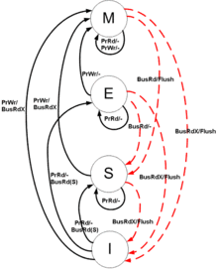
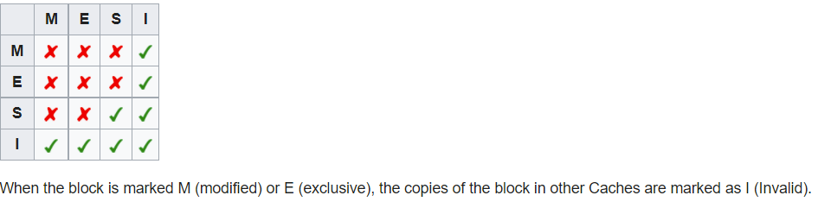
Snooping protocol for caches

Slide 30
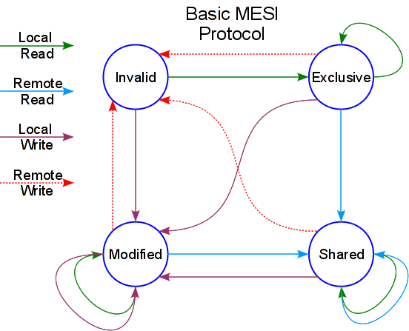
Each cache – managed with MESI

Slide 31
Implementation - POC
How to approach the task

Slide 32
Success points
MESI protocol research
Verilog implementation
Testbench
Verification
TLA+ implementation
Running TLA+ - all possible cases on simulated board
Diagrams, conclusions, approach & writing FYP

Slide 33
Why
Why is it useful to add caches on FPGAs?

Slide 34


Electronic trading Data flow
TCP Ack
+ <3beats
UDP MD
Sim 1005
Xetra QA
Matches ask & bid
MARKET
Vmm 1006
FPGA
Risk check (volume, quantity)
TCP headers
Hearbeat
Fast cxl
Proxima
Builds order book
LDA 07
TCP Ack
+ Heartbeats
Quoterx
Logs
Past orders
UDP Market Data

Slide 35
Electronics trading
Data rd/write
UDP MD
TCP Ack
+ <3beats
Xetra QA
Quoterx
FPGA board
Rd
Basic logic:
Heartbeat
Risk check
Cancels
Dual port RAM
Validates
Rd/Wr
Cache (L1)
Client orders
VMW
Market
Quoterx
Ask/bid
Rd/Wr
Wr

Slide 36
Electronics trading
Data rd/write
UDP MD
TCP Ack
+ <3beats
Xetra QA
Quoterx
FPGA board
Dual port RAM
Requires arbitrator – 2 writes simultaneous
Over N clock cycles
Basic logic:
Heartbeat
Risk check
Cancels
Validates
Client orders
VMW
Market
Quoterx
Ask/bid
Cache Cache (L1)
1. 2x Rd and Writes
2. Up to date changes
3. MESI protocol

Slide 37
Why caching?
Real time orders from Clients, usually repeated (same client several orders)
Access memory for orders = 6 clock cycles
Less delay → act early on the market → bigger benefices
Consistency – keep in state modified for longer if client keep making same orders to ensure safety
Risk management

Slide 38
EXCHANGE SIDE
CPU / MEMORY SIDE
DOWNSTREAM PROCESSOR
Cancel order
(client, amount, £)
Cancel order
(ack, client, amount, £)
Memory reduced risk update (client, cumulated amount)

Slide 39
EXCHANGE SIDE
CPU / MEMORY SIDE
New Cancel (bool)
TOP LEVEL MODULE
New Order (bool)
Order sent/Cancelled
New Max (bool)
Client id new_order (4 bytes)
Client id Cxl_order (4 bytes)
Memory updated
(client, cumulated amount)
Amount new_order (8 bytes)
Amount Cxl_order (8 bytes)

Slide 40
(RISK CHECK)
CPU SIDE
EXCHANGE SIDE
UPSTREAM PROCESSOR
Cumulated reduced risk (cancels)
New order (client, amount, £)
New order
(client, amount, £)
Risk max (client, amount, £)
Cumulated risk (orders)
COMP
A<B : 0
A>B : 1
Memory accumulated risk update
(client, cumulated amount)
Risk check (0/1)
A
-
Max to trade
B

